Slide 1
Homework Assignment 1
Digital Image Processing
Deadline: 09:00 AM, 9/26/2024

Slide 2


Problem 1
The purpose of this homework is to implement a program for image resizing and rotation based on nearest neighbor interpolation, bilinear interpolation, and bicubic interpolation. More precisely, you are asked to find the transformation that registers T.tif with T_transformed.tif. Your program will be tested and evaluated.
Derive the impulse responses of the three interpolation schemes.
T.tif
T_transformed.tif

Slide 3
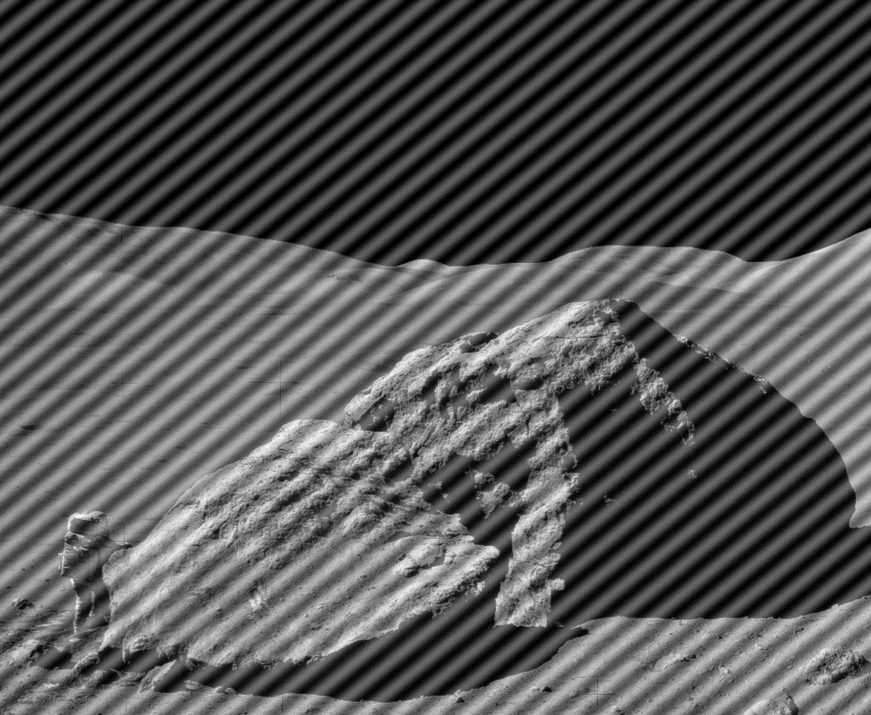
Problem 2
Write a program that takes the noisy image shown in Fig. 2.45(a) as input and generates a clean image as output. Your program will be tested and evaluated. Bonus points will be given if you go beyond the method described in the textbook and design your own.

Slide 4
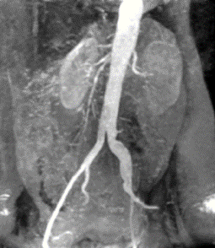
Problem 3
Determine the intensity-level slicing function that would convert the following image to Fig. 3.12(c) and show the difference image between your resulting image and Fig. 3.12(c). Your program will be tested and evaluated. Your score will depend on the quality of your result.

Slide 5
Software Package Allowed
Python 3.8+
Standard Python library
Numpy 1.21.1
Opencv-python 4.5.1

Slide 6
Assignment Requirements
Only the Image IO of the Software Package is allowed, other image operations (interpolation, filtering, etc.) should be written by yourself.
Set your directory structure as follows:
R109XXXXX/
- p1.py
- p2.py
- p3.py
- report.pdf
- images/
- image_2.bmp, image_3.png, T.tif, T_transformed.tif
- Images of program output

Slide 7
Assignment Submission Requirements
Submit to NTU COOL
Do NOT copy homework (code, report, results, etc.) from others

Slide 8
Grading Policy
Problem 1(a) (40%)
6% for each interpolation scheme, if the result is correct.
6% for each impulse response, if correct.
4%, elegance of your technique.
Problem 2 (30%)
15%, if the transformation is correct
15%, if the code generates correct result
Problem 3 (30%)
20%, if the intensity-level slicing function looks fine
10%, if the difference image is small enough

